Slide 1
Gaffer-Project Monitor
Presented by
Dipesh Shrestha
1NH17CS039

Slide 2
Objectives
The successful organization of multiple teams, clients and projects.
To provide the visual representation of data collected.
Continuous monitoring on the progress of each team members.
To replace the traditional paper work with digital report.
To facilitate with the separate windows for team lead and the members.

Slide 3
Brief Overview
It has separate windows for the Team Lead and the Team Members.
Team Lead can:
Sign Up and Log In.
Add new client, projects and members.
View each members information, progress in each project in bar chart.
Update due date of projects.
Send message to Team Members.
Team Member can:
Only Log In.
Update their progress on the particular project.
Can view message sent by the Team Lead.

Slide 4
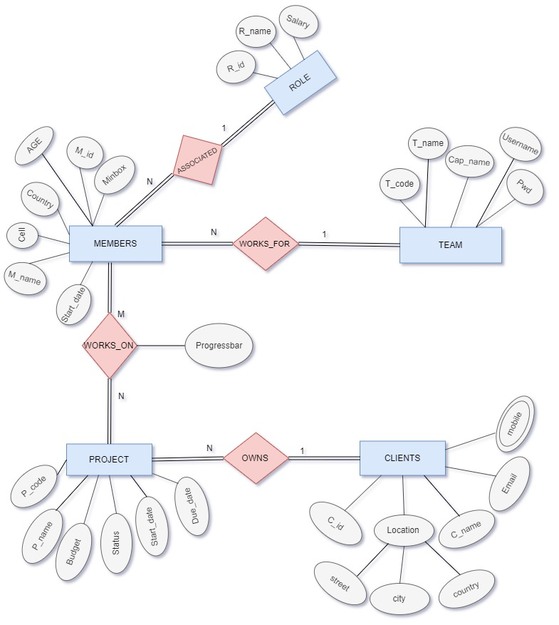
ER Diagram

Slide 5

Taskade App in Play Store
Rating: 4.6
Downloads: 10K+
Released on: 13th Mar, 2018

Slide 6
How is Gaffer different from Taskade?
There is no any separate space for Team Lead and the Members (abstraction) but Gaffer do provide.
Gaffer provides visualization on collected data whereas Taskade didn’t have any visualization on data.

Slide 7
Pros And Cons
PROS:
Better visualization of collected data.
Feature to update due date of project.
CONS:
Software engineering techniques are not implemented.
No interaction facility between the team members.

Slide 8
Future Scope
In future, An algorithm will be implemented for “Automatic Assignment” of newly added project to the best team members instead of assigning manually by the captain.
So far I have researched there is no such project/team management app in play store that has implemented this feature.

Slide 9
THANK YOU!

